Slide 1


R. GLENN HUBBARD
ANTHONY PATRICK O’BRIEN
FIFTH EDITION
© 2015 Pearson Education, Inc.

Slide 2
Comparative Advantage and the Gains from International Trade

Slide 3
Is it right to save jobs in the tire industry?
Between 2004 and 2008 Chinese tire companies tripled exports to the United States.
In fall 2009, President Obama responded with a tariff on tire imports from China of 35% of the tire’s value.
Why? This would protect U.S. tire producing firms, and fewer tire industry workers would lose their jobs.
China responded by raising tariffs on some U.S. goods.
In 2012, President Obama allowed the tariff to expire. Tire imports from China started to rise again.
Did the tariffs in the tire industry make us better or worse off?

Slide 4
The United States in the International Economy
9.1
Discuss the role of international trade in the U.S. economy.

Slide 5
The United States and international trade
International trade has grown more and more important to the world economy over the past 50 years.
Falling shipping and transportation costs have made international trade more profitable and desirable.
Traditionally, countries imposed high tariffs on imports, believing that such measured made their own firms and consumers better off.
But that meant their exports were similarly taxed.
Tariff: A tax imposed by a government on imports
Imports: Goods and services bought domestically but produced in other countries.
Exports: Goods and services produced domestically but sold in other countries.

Slide 6
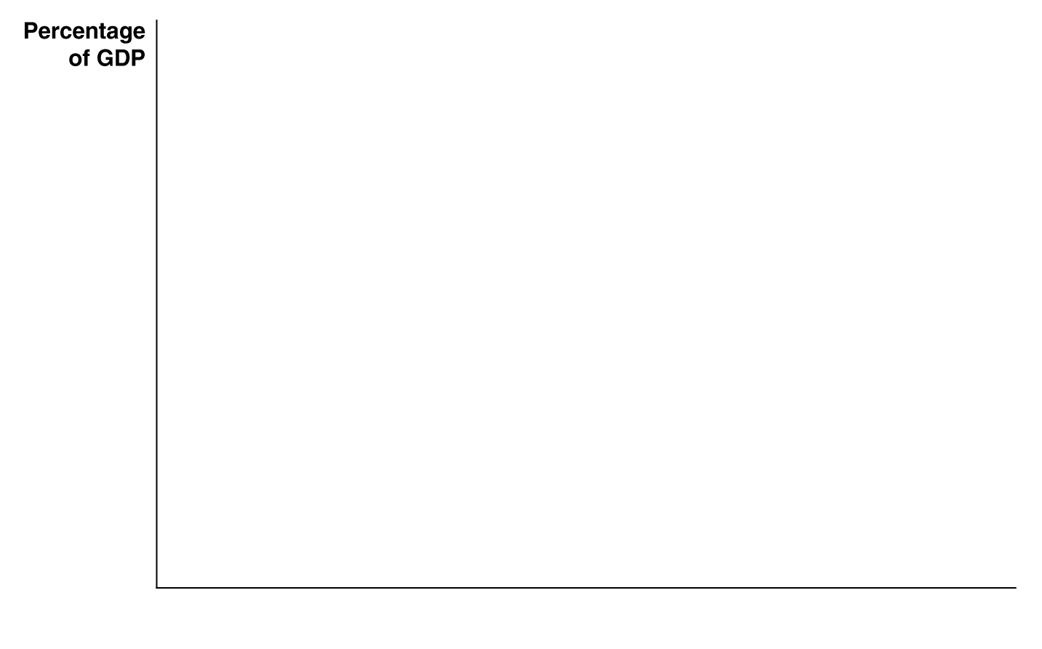
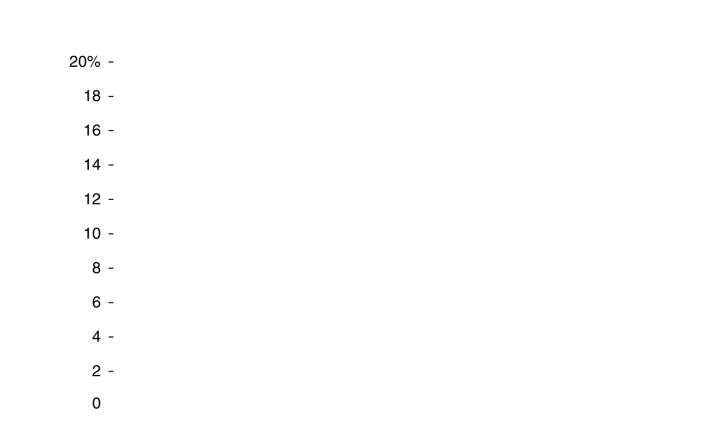
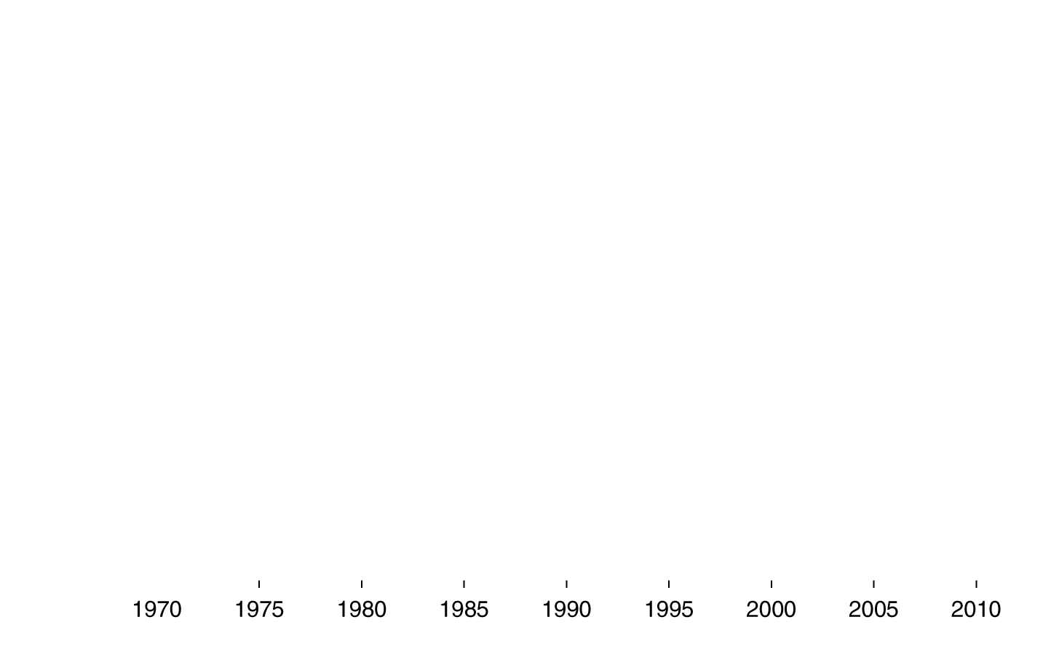

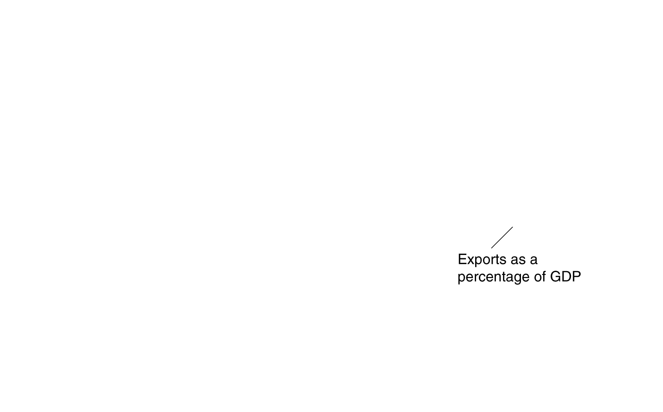
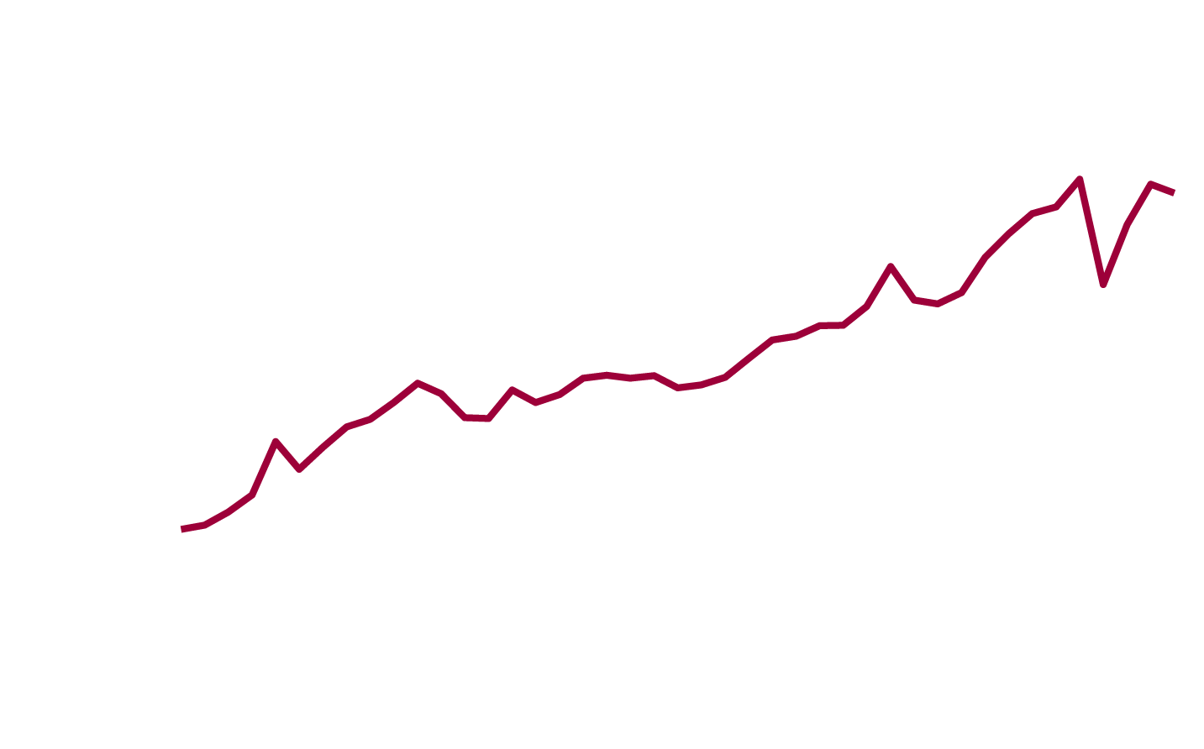
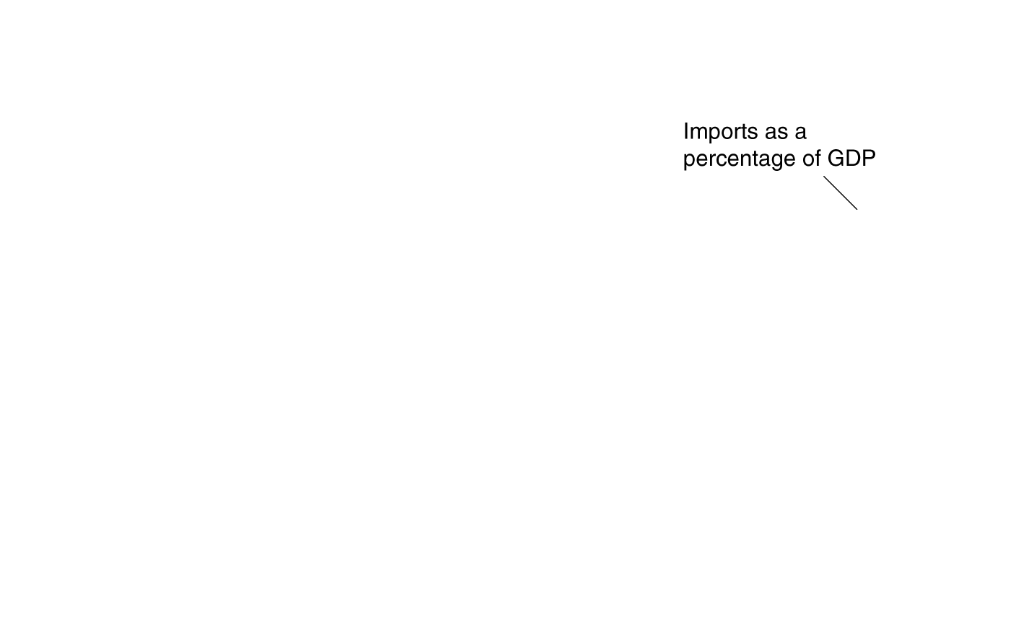
The increasing importance of trade to the U.S.
Since 1970, both imports and exports have been steadily rising as a fraction of U.S. gross domestic product (GDP).
International trade has been becoming a more and more important part of the American economy.
Figure 9.1
International trade is of increasing importance to the United States
Notes:
Exports and imports of goods and services
as a percentage of total production—
measured by GDP—show the importance
of international trade to an economy. Since
1970, both imports and exports have been
steadily rising as a fraction of U.S. GDP.
Source: U.S. Department of Commerce,
Bureau of Economic Analysis.

Slide 7
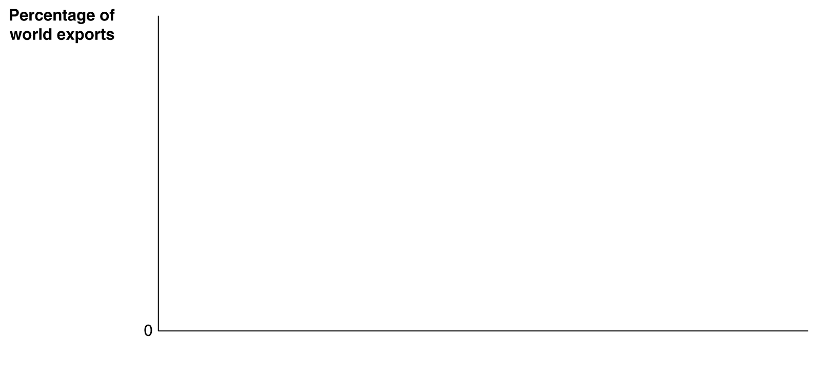
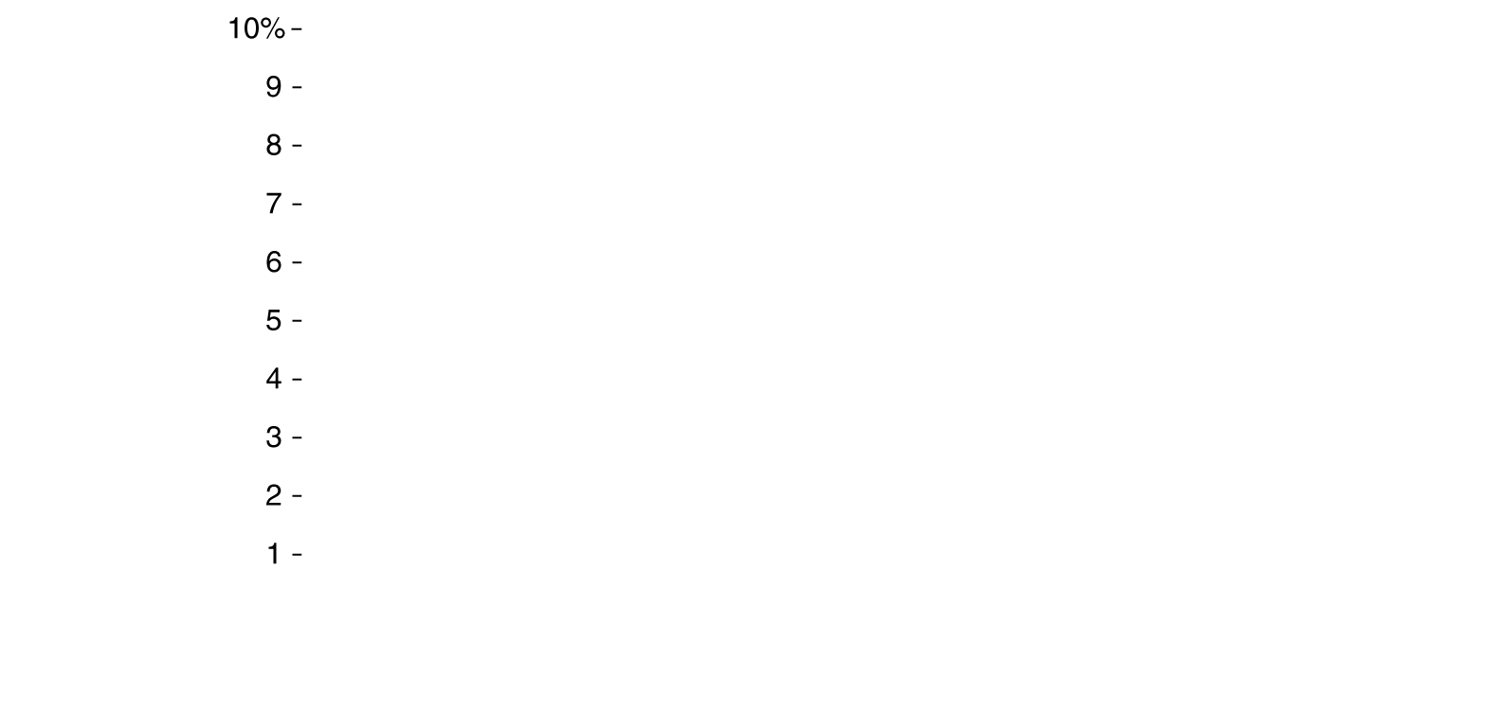







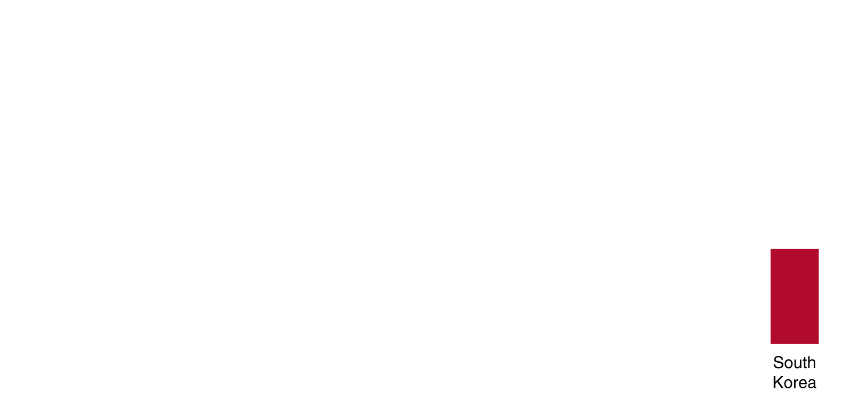
Leading exporting countries, 2012
The rapid growth of the Chinese economy has made it the world’s largest exporter, with 9.3% of world exports.
China took over the lead from the U.S., which accounts for 9.2% of world exports.
Figure 9.2
The eight leading exporting countries, 2012
Notes:
China is the leading exporting country, accounting
for 9.3 percent of total world exports.
The United States is second, with a
9.2 percent share. The values are the shares
of total world exports of merchandise and
commercial services.
Source: World Trade Organization,
International Trade Statistics, 2012.

Slide 8
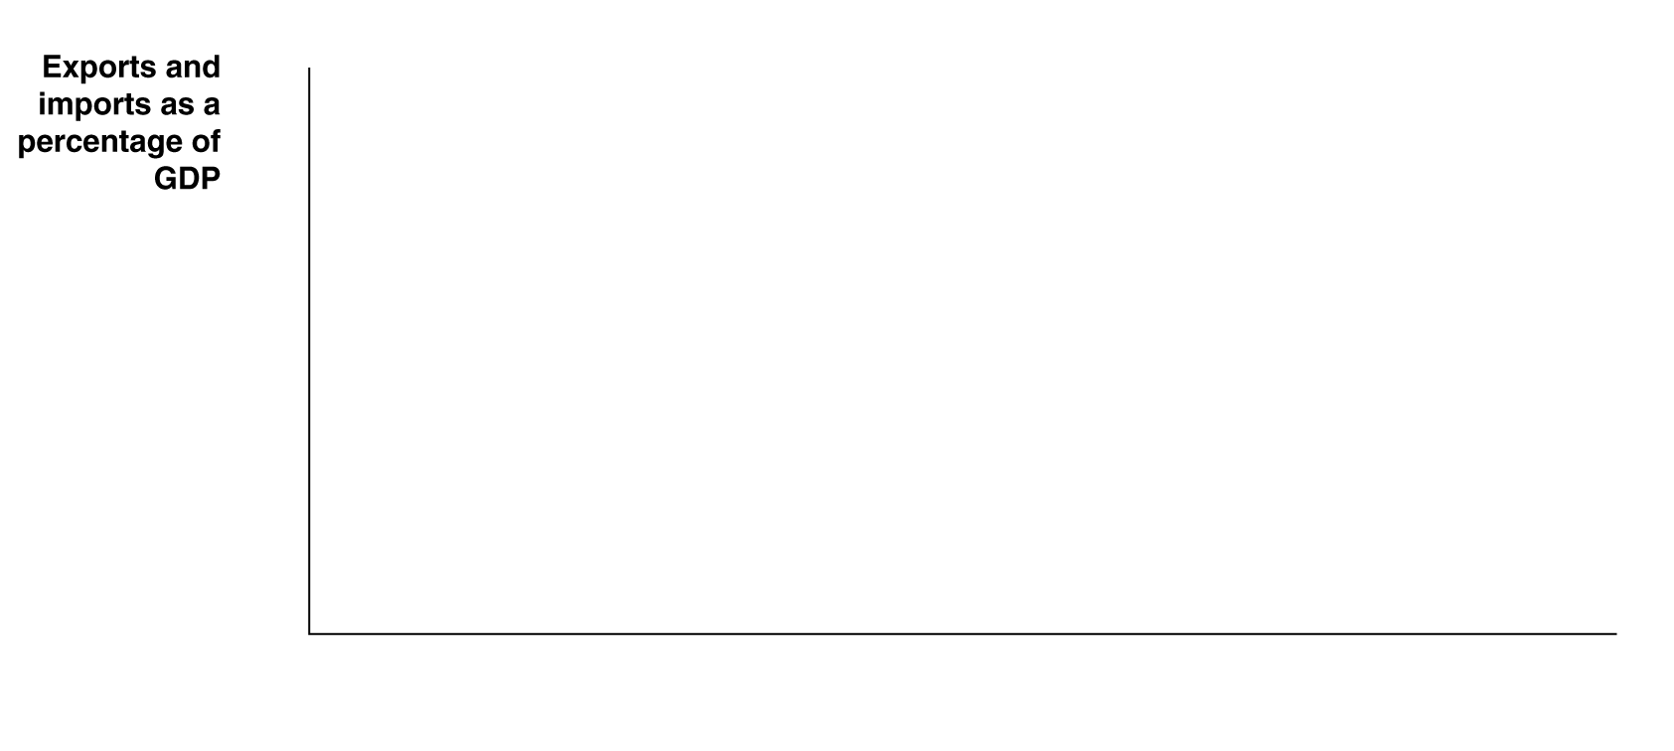

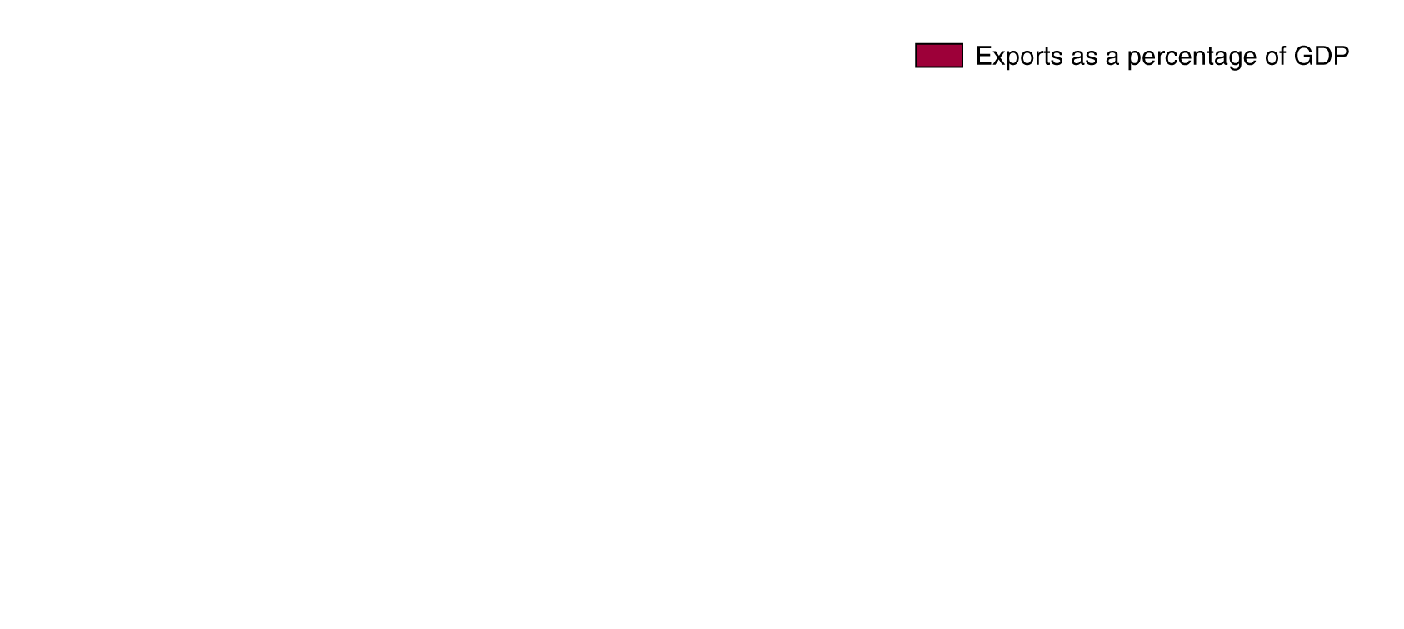









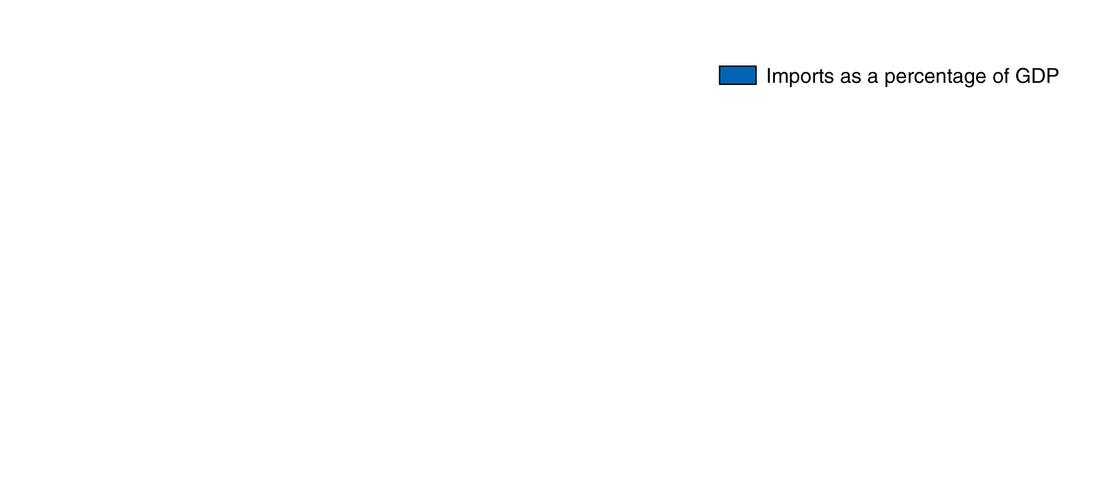









International trade as a percentage of GDP
However trade is less important to the U.S. (and China as well) than it is to other countries—largely due to the relative sizes of economies.
Figure 9.3
International trade as a percentage of GDP
Notes:
International trade is still less important to
the United States than it is to most other
countries.
Source: Organization for Economic
Cooperation and Development, Country
Statistical Profiles.

Slide 9
Goodyear and the tire tariff
You would think Goodyear, a major U.S. tire manufacturer, would have benefited strongly from reduced competition due to the tire tariff. However a spokesman for Goodyear said:
“The tariffs didn’t have any material impact on our North America business. The stuff coming in from China is primarily low end. We got out of that market years ago.”
Even worse, tires from some of Goodyear’s factories in China were subject to the tariff!
At the beginning of 2013, with the tire tariff expiring, Goodyear’s profits rose more than 50 percent, despite imports of Chinese tires.

Slide 10
Comparative Advantage in International Trade
9.2
Understand the difference between comparative advantage and absolute advantage in international trade.

Slide 11
Comparative and absolute advantage
In Chapter 2 we introduced the concept of comparative advantage: being able to produce something at a lower opportunity cost than someone else.
In the table, Japan has an absolute advantage in producing both cell phones and tablet computers: it can produce each with fewer resources (hours of work) than can the U.S..
But comparative advantage means that trade can still be advantageous for both nations.
 |  | Output per Hour of Work
 | Cell Phones |  | Tablet Computers
Japan | 12 |  | 6
United States | 2 |  | 4
Table 9.1
An example of Japanese workers being more productive than American workers

Slide 12
Comparative advantage in international trade
This table shows what has to be given up to create each good: the opportunity cost.
If the nations were in autarky, a situation in which they did not trade with other countries, these would also be the relative prices in each country: a cell phone would trade for half the price of a tablet computer in Japan, and double the price of a tablet computer in America.
Japan would like to trade its cell phones for American tablets, and vice versa.
 |  | Opportunity Costs
 | Cell Phones |  | Tablet Computers
Japan | 0.5 tablet |  | 2 cellphones
United States | 2 tablet |  | 0.5 cellphone
Table 9.2
The opportunity costs of producing cellphones and tablets

Slide 13
How Countries Gain from International Trade
9.3
Explain how countries gain from international trade.

Slide 14
Production in autarky
Suppose that initially each country has 1000 hours to spend.
In that time, Japan might produce 9000 cell phones and 1500 tablet computer.
In the same time, the U.S. might produce 1500 cell phones and 1000 tablet computers.
In total, 10500 cell phones and 2500 tablet computers are produced.
 | Production and Consumption
 | Cell Phones | Tablet Computers
Japan | 9,000 | 1,500
United States | 1,500 | 1,000
Table 9.3
Production without trade

Slide 15
Production in autarky—preparing for trade
Observe what happens if each country specializes in its comparative advantage:
Japan can produce 12000 cell phones.
The U.S. can produce 4000 tablet computers.
In total, 12000 cell phones and 4000 tablet computers are produced.
 | Production and Consumption
 | Cell Phones | Tablet Computers
Japan | 12,000 | 0
United States | 0 | 4,000

Slide 16
Deciding on terms of trade
The terms of trade are the ratio at which a country can trade its exports for imports from other countries.
No country would accept terms of trade worse than its opportunity cost—it would be better off producing by itself the goods that it was importing.
Terms of trade of one-for-one could be acceptable to both Japan and the United States.
With these terms, they might trade 1500 cell phones for 1500 computers, ending with the consumption below:
 | Production and Consumption
 | Cell Phones | Tablet Computers
Japan | 10,500 | 1,500
United States | 1,500 | 2,500

Slide 17
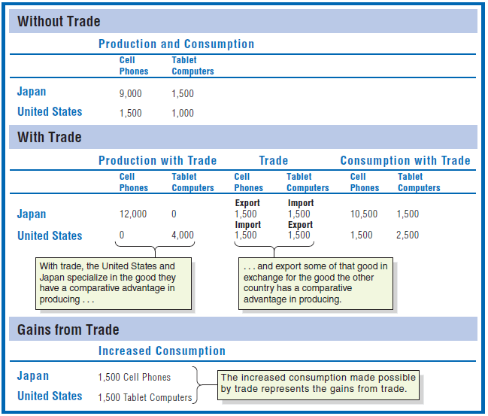
Summary of the gains from trade
Table 9.4
Gains from trade for Japan and the United States

Slide 18
Why don’t we see complete specialization?
In the real world, products are not generally produced by only one nation. Reasons include:
Not all goods and services can be traded internationally (medical services, for example).
Production of many goods involves increasing opportunity costs (so small amounts of production are likely to take place in several countries)
Tastes for products differ (cars, for example); countries might have comparative advantages in different sub-types of products.

Slide 19
What’s the bad news about international trade?
So far, we have made it appear that international trade is going to be good for everybody.
But this is true only on a national level.
Some individual firms and consumers will lose out due to international trade; in our example:
Japanese tablet computer firms and their workers
American cell phone firms and their workers
These groups would likely ask their governments to implement protectionist measures like tariffs and quotas, in order to protect them from foreign competition.
Quota: A numerical limit a government imposes on the quantity of a good that can be imported into that country.

Slide 20
Where does comparative advantage come from?
Comparative advantage can derive from a variety of natural and man-made sources:
Climate and natural resources
Some nations are better-suited to particular types of production; particularly important for agricultural goods.
Relative abundance of labor and/or capital
Some nations have lots of high- or low-skilled workers, or relatively much or little infrastructure.
Technological differences
Technologies may not diffuse quickly or uniformly.
External economies
Reductions in a firm’s costs may result from an increase in the (local) size of that industry; think Silicon Valley, Hollywood, or Wall Street.

Slide 21

Leaving New York is risky for financial firms
In the early 19th century, New York City benefited from the Erie Canal bringing commerce from upstate New York to the city.
Consequently, many financial firms (banks, traders, etc.) located in Manhattan.
Now there is no particular natural advantage for financial firms to locate in Manhattan.
But proximity to similar firms generates external economies for those firms.
If a financial firm chooses to locate out of Manhattan, it experiences higher costs of doing business with other firms located in Manhattan.

Slide 22
Comparative advantage over time—U.S. electronics
For several decades, the U.S. had a comparative advantage in producing consumer electronics (TVs, radios, etc.), due to having modern factories and a skilled and experienced work force.
Over time, other countries like Japan developed superior process technologies, allowing them to streamline production of these goods, and produce them cheaper than U.S. firms.
Rising Asian wages are starting to drive the production of consumer electronic devices back to America, along with the high computer and software design requirements of many current consumer electronic devices.
Example: In 2013, Apple announced that its redesigned Mac Pro would be assembled in the United States

Slide 23
Government Policies That Restrict International Trade
9.4
Analyze the economic effects of government policies that restrict international trade.

Slide 24


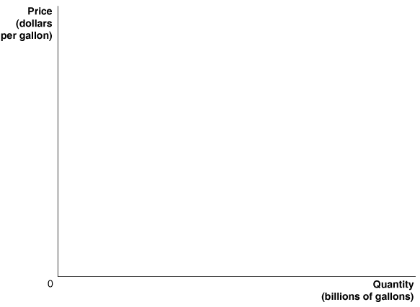
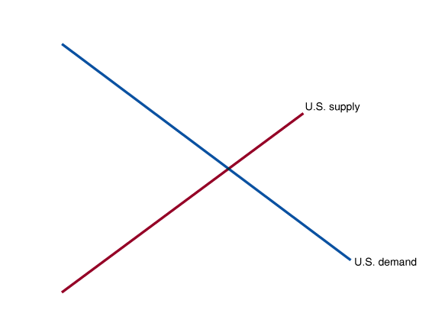
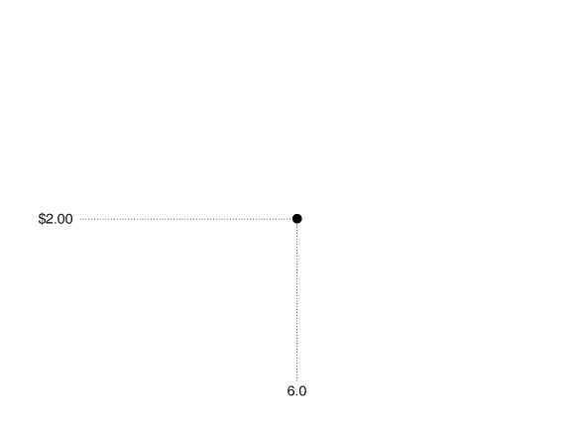
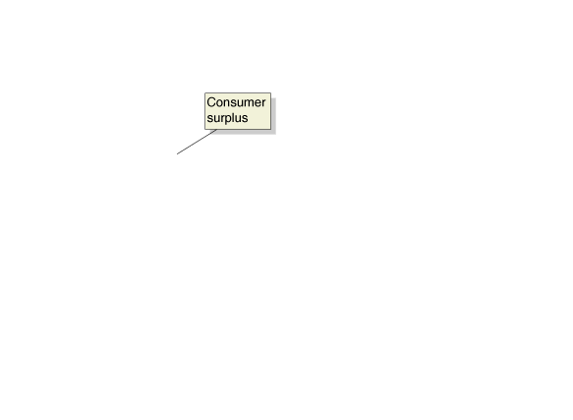
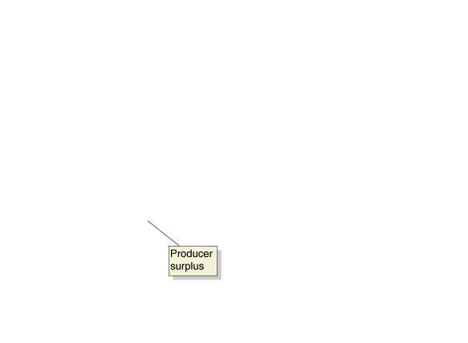
Surplus when trade is not allowed
If trade is not allowed in the U.S. market for ethanol, all domestic consumption will be met by domestic production.
Consumers who are willing to pay at least $2.00 per gallon purchase ethanol, and obtain consumer surplus.
Domestic producers with costs lower than $2.00 per gallon sell their ethanol, and obtain producer surplus.
Figure 9.4
The U.S. market for ethanol under autarky
Notes:
This figure shows the market for ethanol in
the United States, assuming autarky, where
the United States does not trade with other
countries. The equilibrium price of ethanol
is $2.00 per gallon, and the equilibrium
quantity is 6.0 billion gallons per year. The
blue area represents consumer surplus, and
the red area represents producer surplus.

Slide 25
Joining the world ethanol market
Now suppose the American government decides to open up imports and/or exports of ethanol.
Assume that the world price of gasoline is $1.00 per gallon:
American will import ethanol.
American consumers will benefit from cheaper ethanol.
American ethanol producers will suffer, with a lower price.
How can we decide whether allowing free trade makes Americans better off overall?
By comparing the economic surplus in the market with and without free trade.
Free trade: Trade between countries that is without government restrictions.

Slide 26



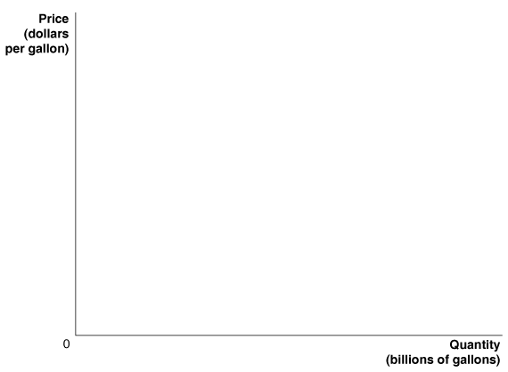
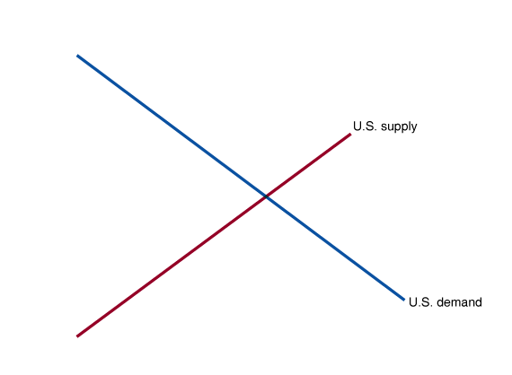
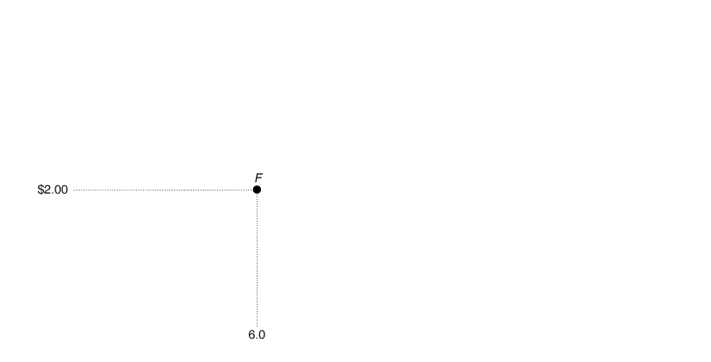
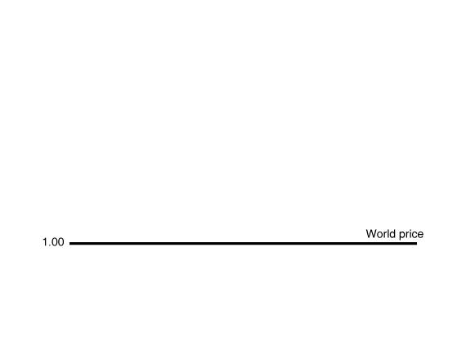
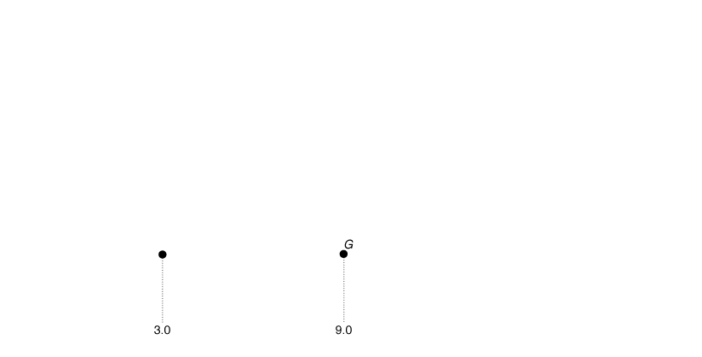

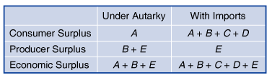
Change in economic surplus due to trade
When imports are allowed, price falls to $1.00 per gallon.
U.S. production falls to 3.0 billion; U.S. consumption rises to 9.0 billion.
Hence 6.0 million gallons are imported.
Consumer surplus rises to A+B+C+D.
Producer surplus falls to E.
Overall, economic surplus rises; the gains to consumers outweigh the losses to producers.
Figure 9.5
The effect of imports on the U.S. ethanol market
Notes:
When imports are allowed into the United
States, the price of ethanol falls from
$2.00 to $1.00. U.S. consumers increase
their purchases
from 6.0 billion gallons to
9.0 billion
gallons. Equilibrium moves from
point F to point G. U.S. producers reduce
the quantity of ethanol they supply from
6.0 billion gallons to 3.0 billion gallons. Imports
equal 6.0 billion gallons, which is the
difference between U.S. consumption and
U.S. production. Consumer surplus equals
the sum of areas A, B, C, and D. Producer
surplus equals the area E.

Slide 27
Government policies in restriction of trade
Firms that face competition from imported goods lose out when trade is allowed.
These firms appear to deserve sympathy, especially when their workers start to lose their jobs.
Consequently, they can often convince governments to restrict trade; usually with one of the following:
Tariffs:
Taxes imposed by a government on goods imported into a country.
Quotas and Voluntary Export Restraints (VERs):
Limits imposed upon (quotas) or negotiated between (VERs) countries on the quantity of a good imported by one country from another.

Slide 28





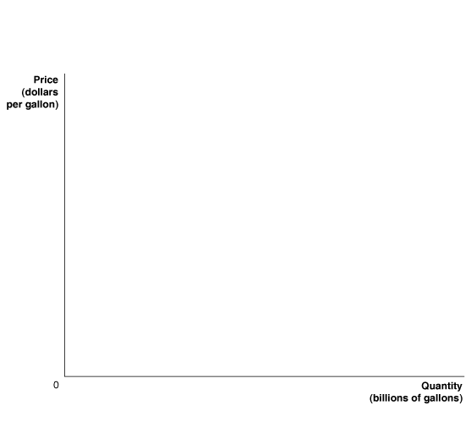
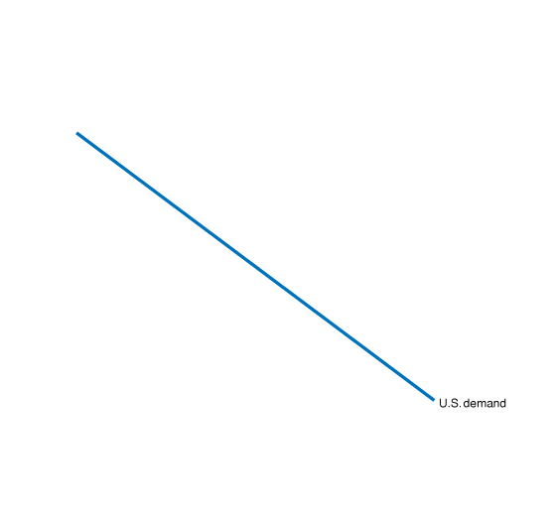
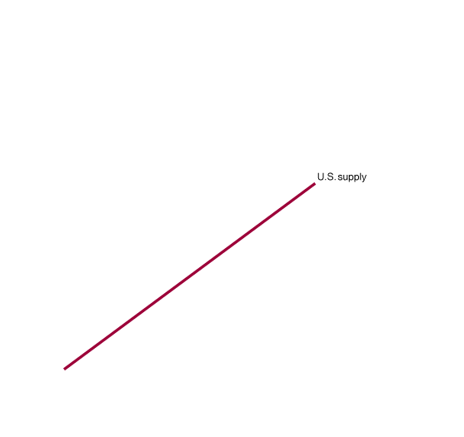
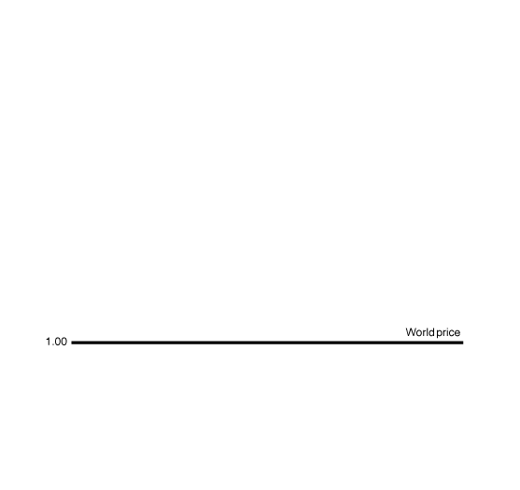
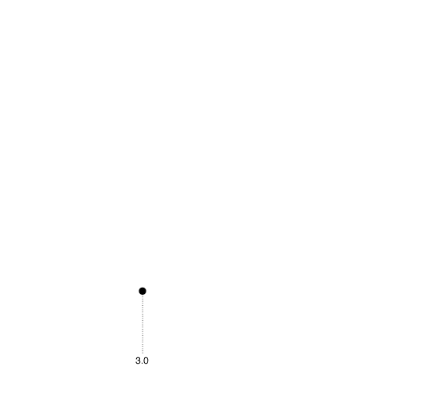
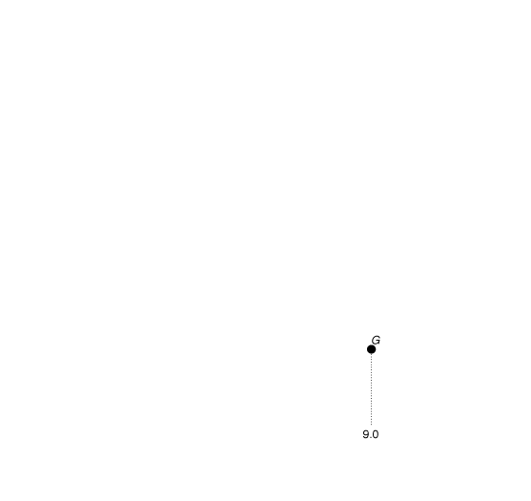
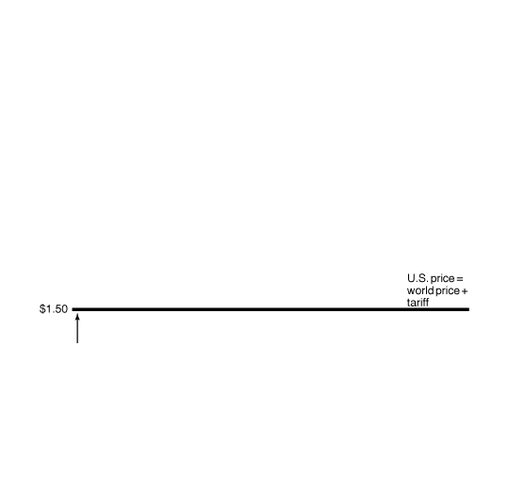
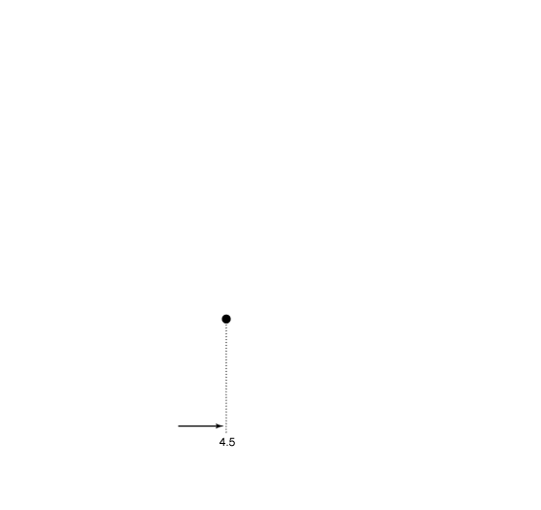
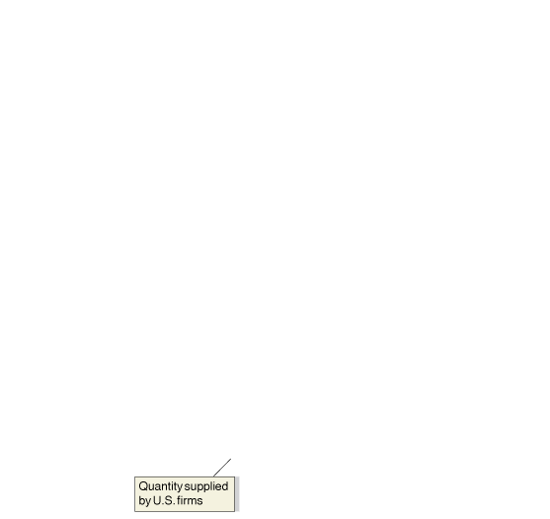
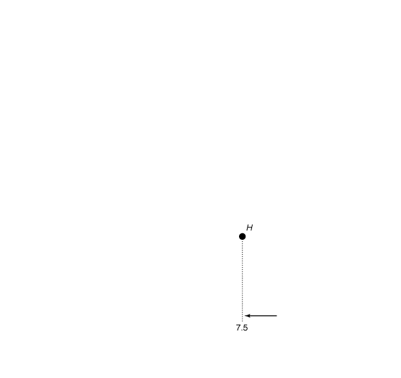


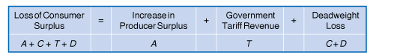
Effect of a tariff on economic surplus
We return to the market for ethanol.
If the government imposes a $0.50 per gallon tariff, price rises to $1.50.
U.S. production rises, and U.S. consumption falls.
Producer surplus rises by A.
The government gains tariff revenues (T).
But consumer surplus falls by A+C+T+D.
Overall, economic surplus falls by C+D: deadweight loss.
Figure 9.6
The effects of a tariff on ethanol
Notes:
Without a tariff on ethanol, U.S. producers
will sell 3.0 billion gallons of ethanol, U.S.
consumers will purchase 9.0 billion gallons,
and imports will be 6.0 billion gallons.
The U.S. price will equal the world price of
$1.00 per gallon. The $0.50-per-gallon tariff
raises the price of ethanol in the United
States to $1.50 per gallon, and U.S. producers
increase the quantity they supply to
4.5 billion
gallons.
U.S. consumers reduce
their purchases to 7.5 billion gallons. Equilibrium
moves from point G to point H.
The ethanol tariff causes a loss of consumer
surplus equal to the area A + C + T + D.
The area A is the increase in producer surplus
due to the higher price. The area T is
the government’s tariff revenue. The areas C
and D represent deadweight loss.

Slide 29
Import quota in the U.S. sugar market
Quotas and voluntary export restraints are effectively similar; the difference is that quotas are imposed unilaterally (by one country), whereas VERs are negotiated agreements.
The United States imposes a sugar quota, allowing no more than 5.8 billion pounds of sugar to be imported.
This keeps the U.S. price of sugar ($0.43 per pound) higher than the world price ($0.27), generating large benefits for U.S. sugar producers, at the expense of U.S. sugar consumers.
On the next slide, we will calculate just how much each party is hurt or helped.

Slide 30
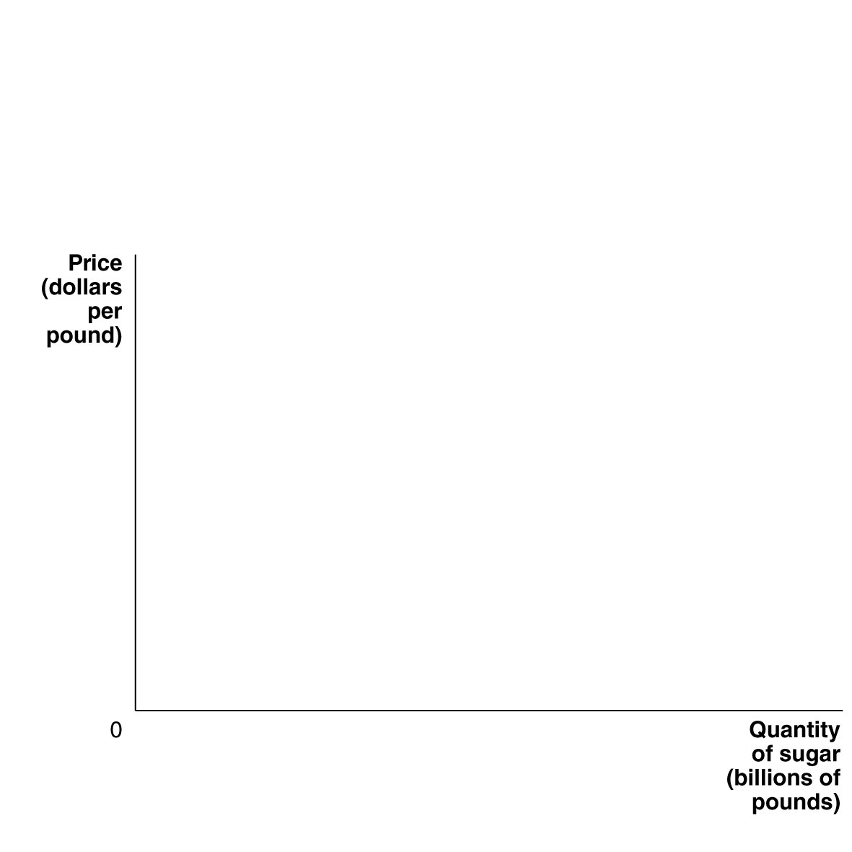
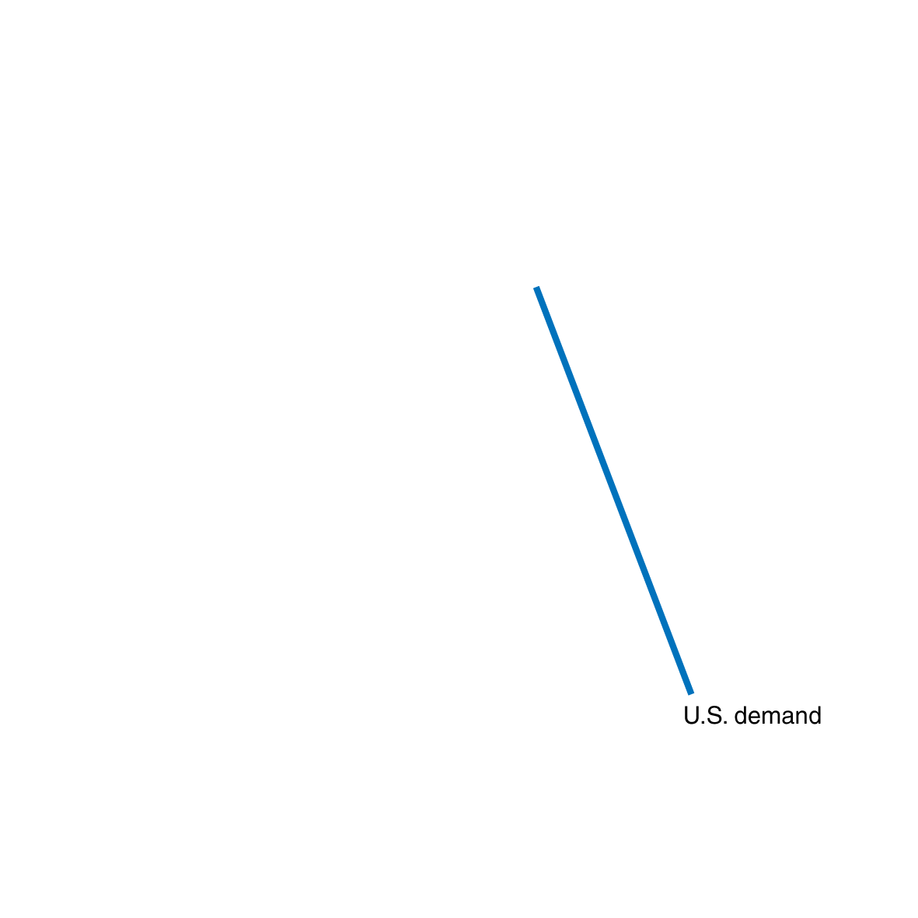
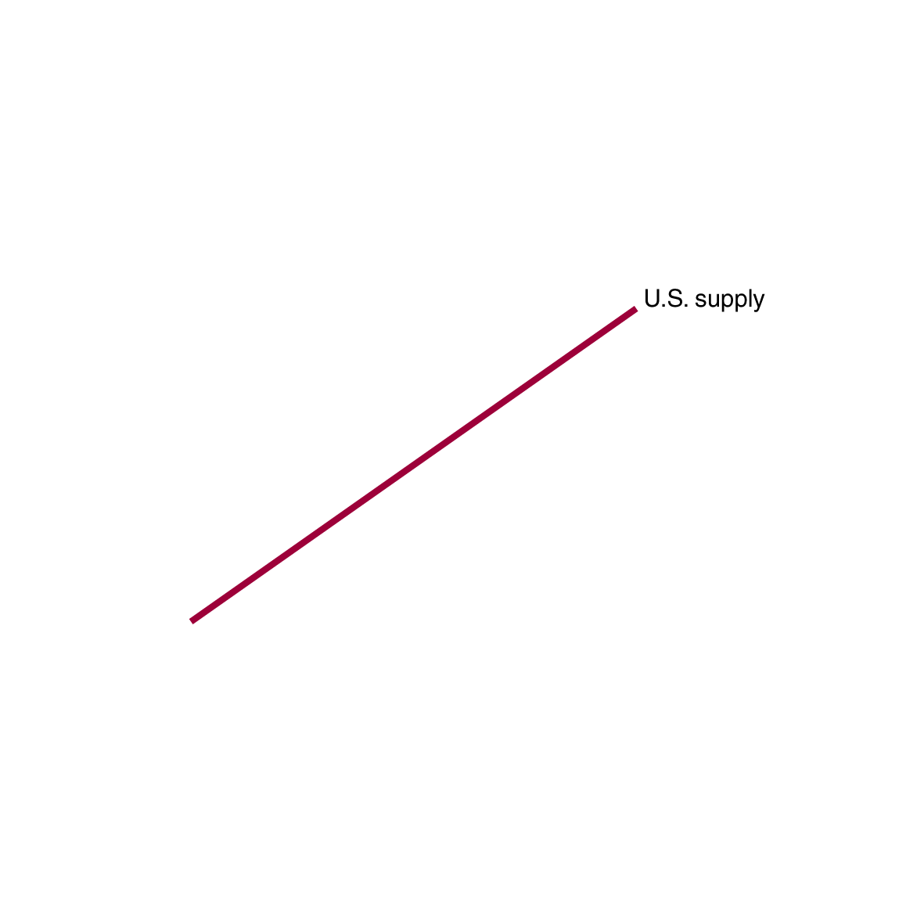
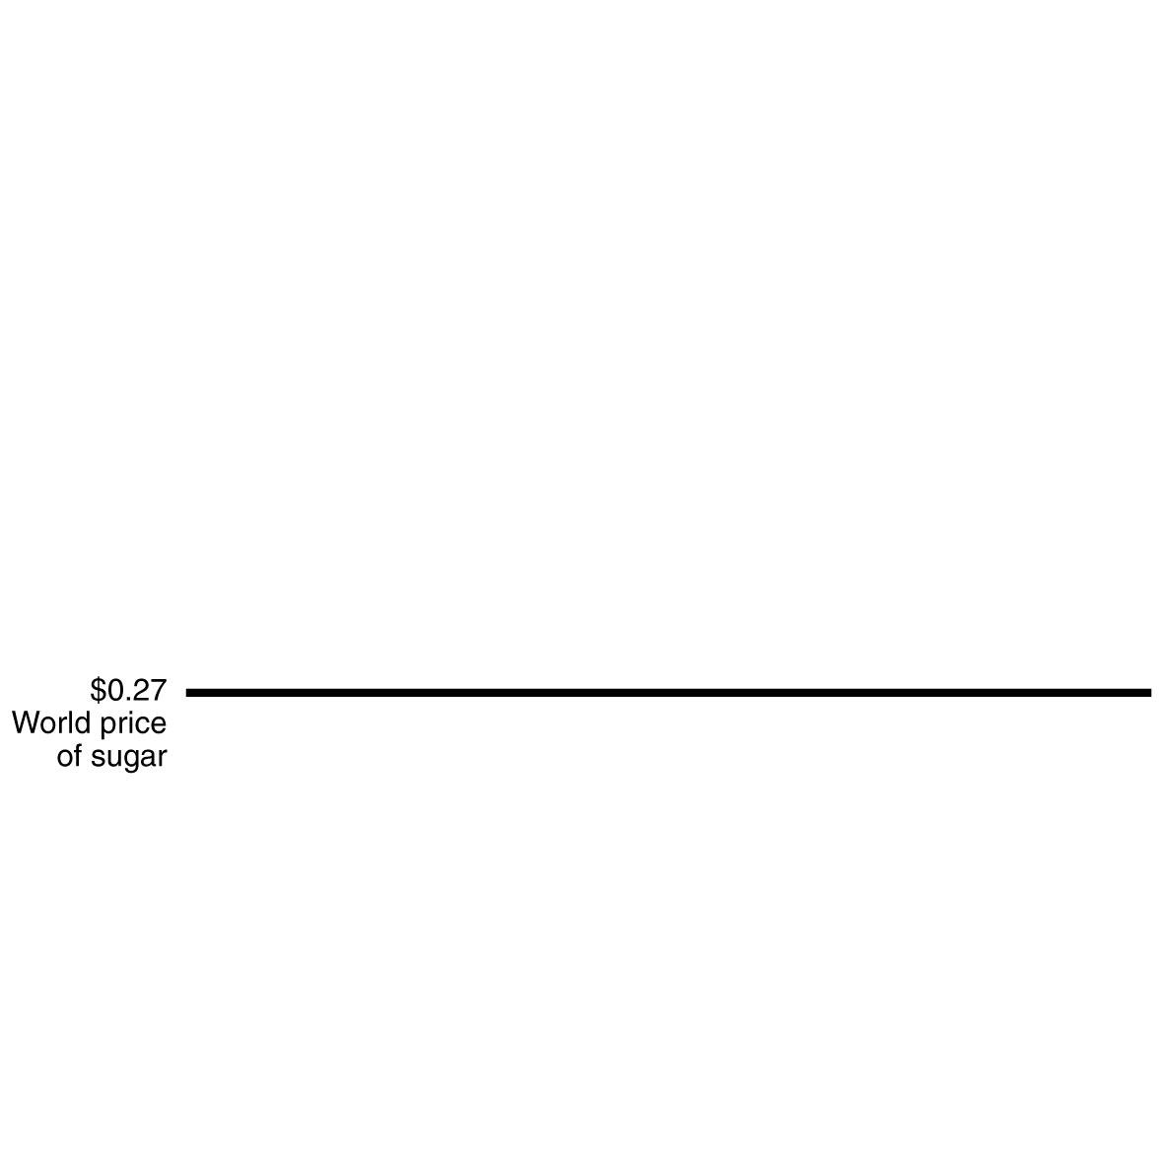
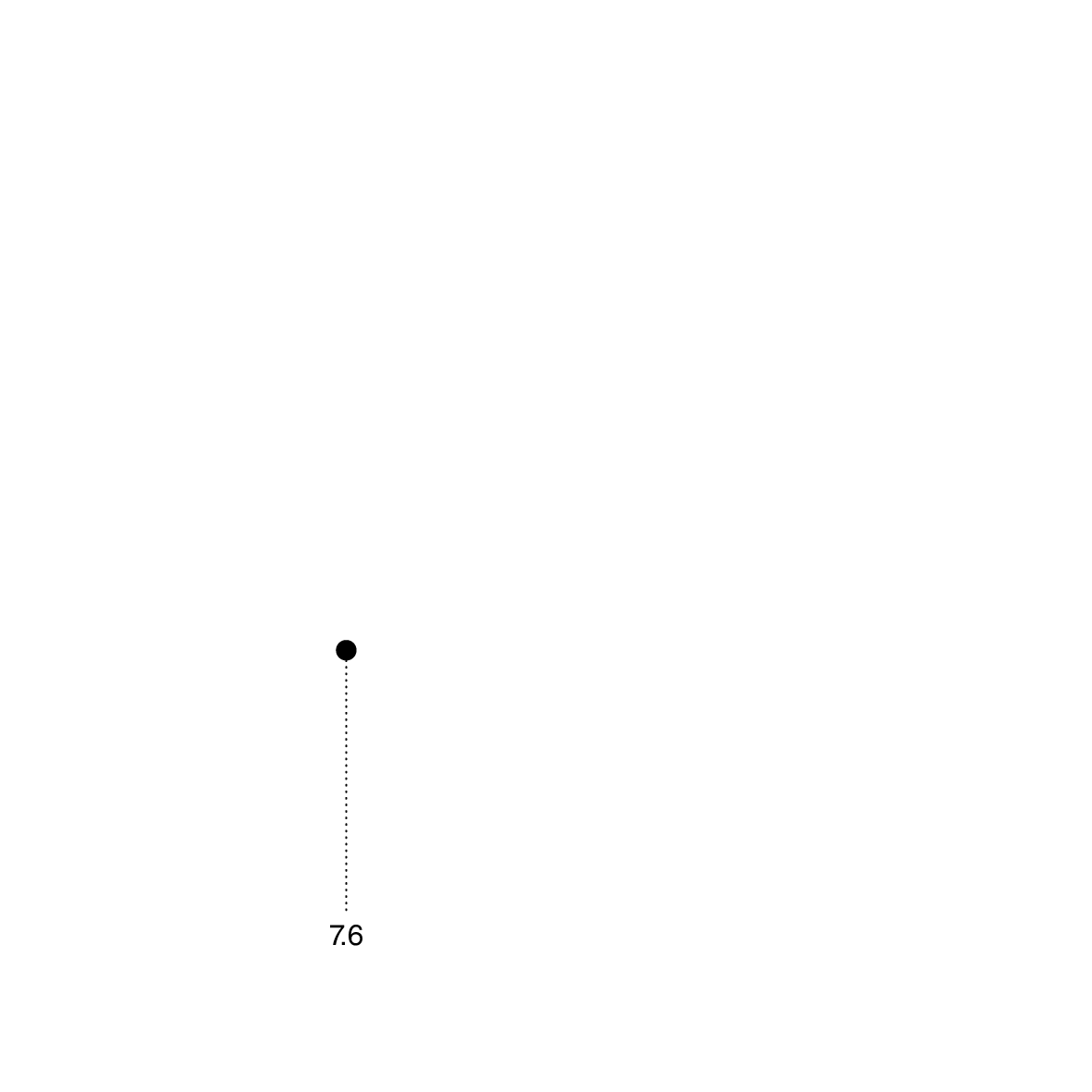
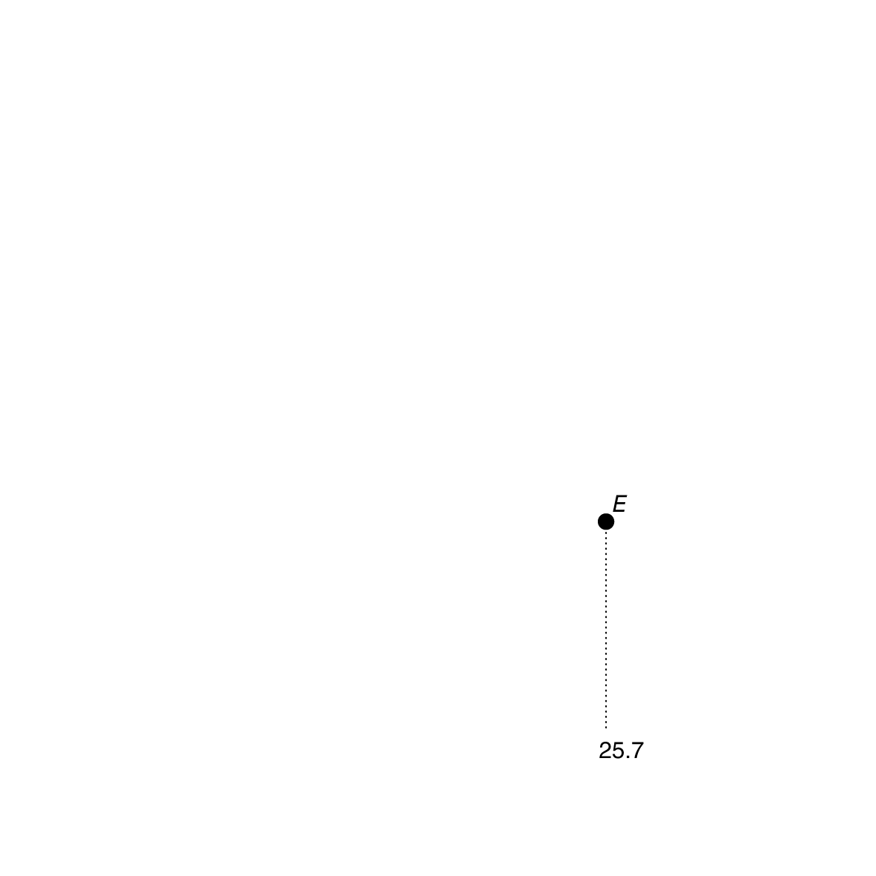
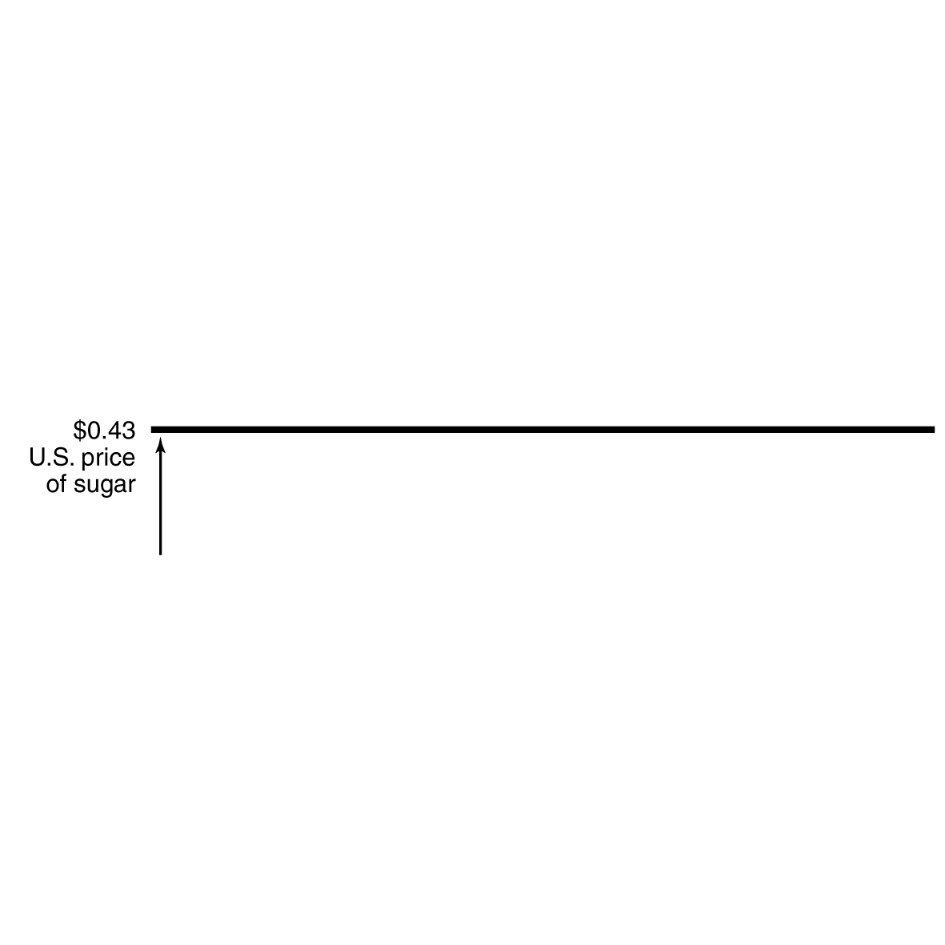
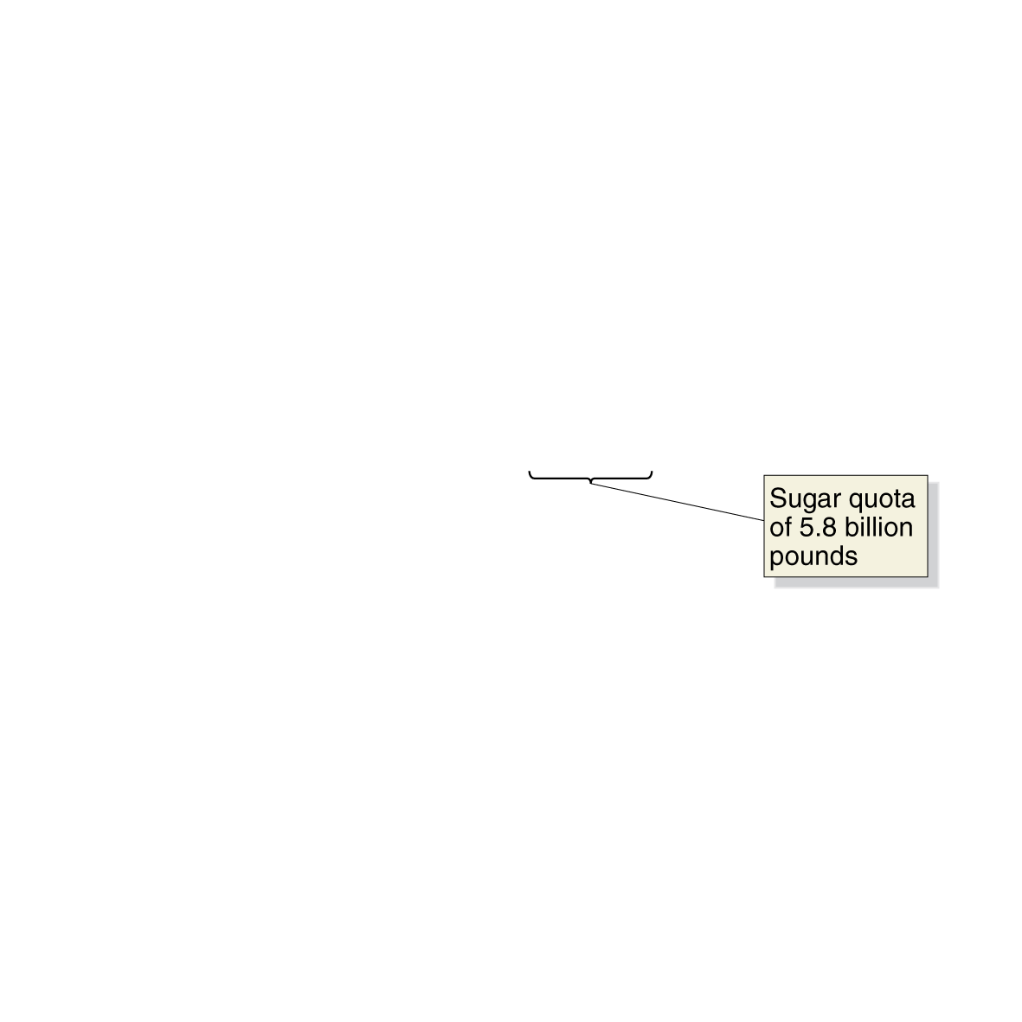
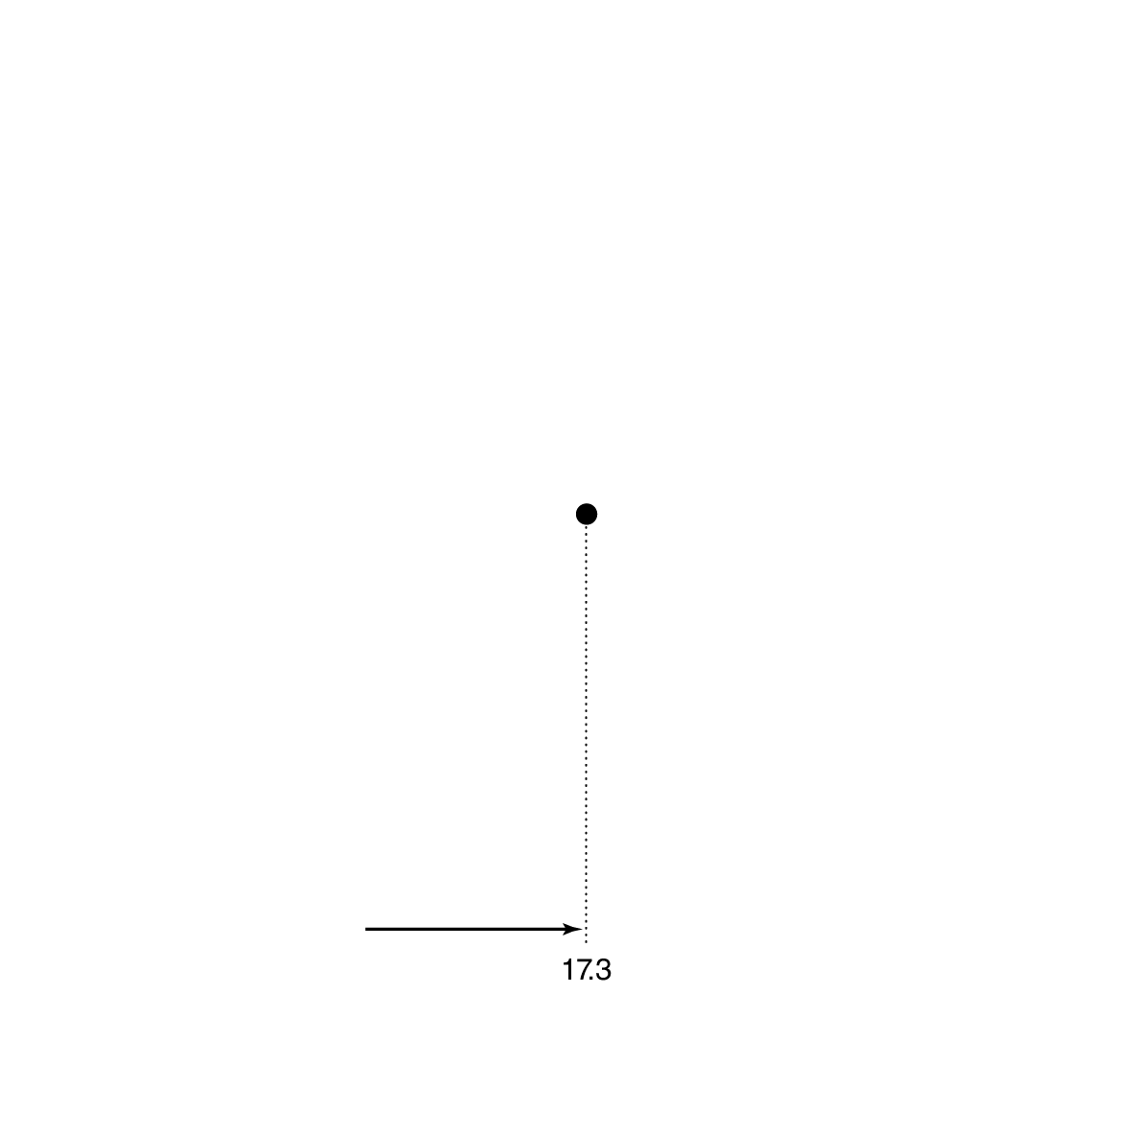

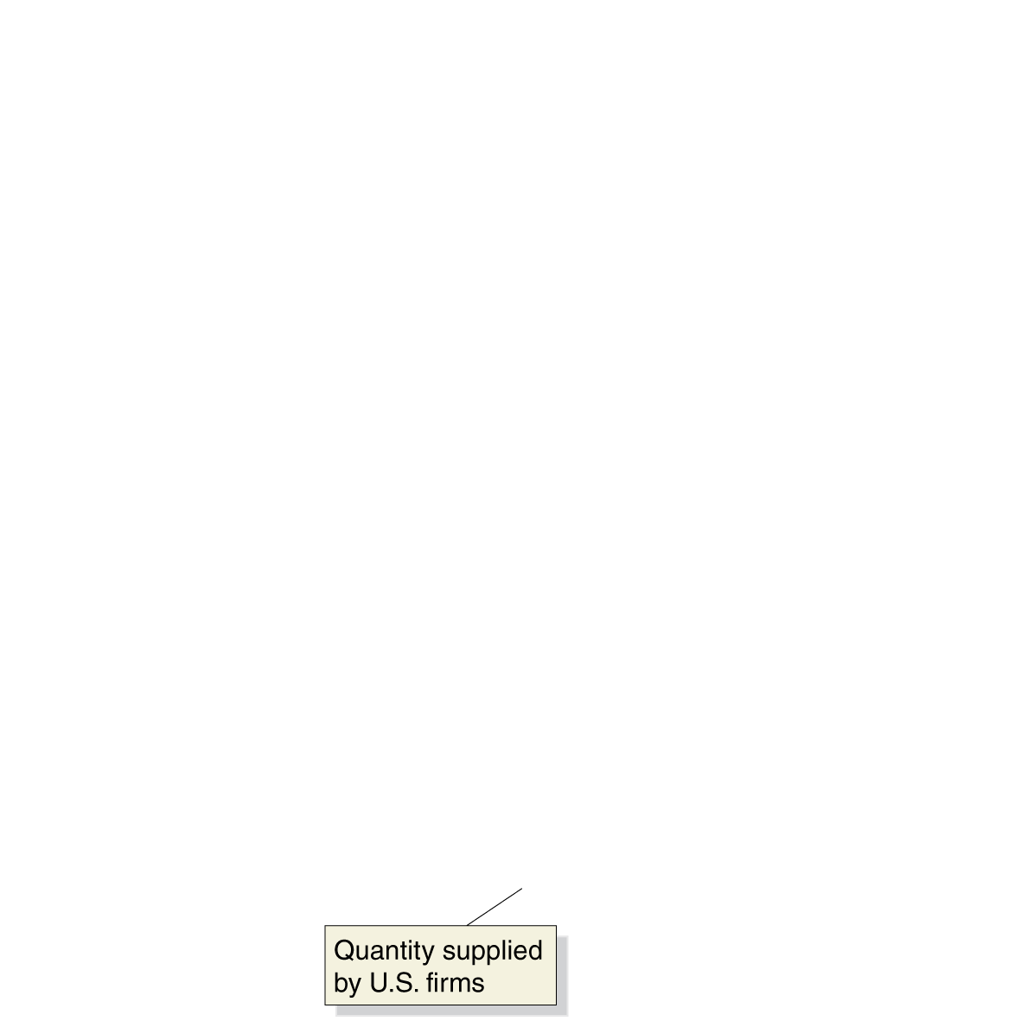
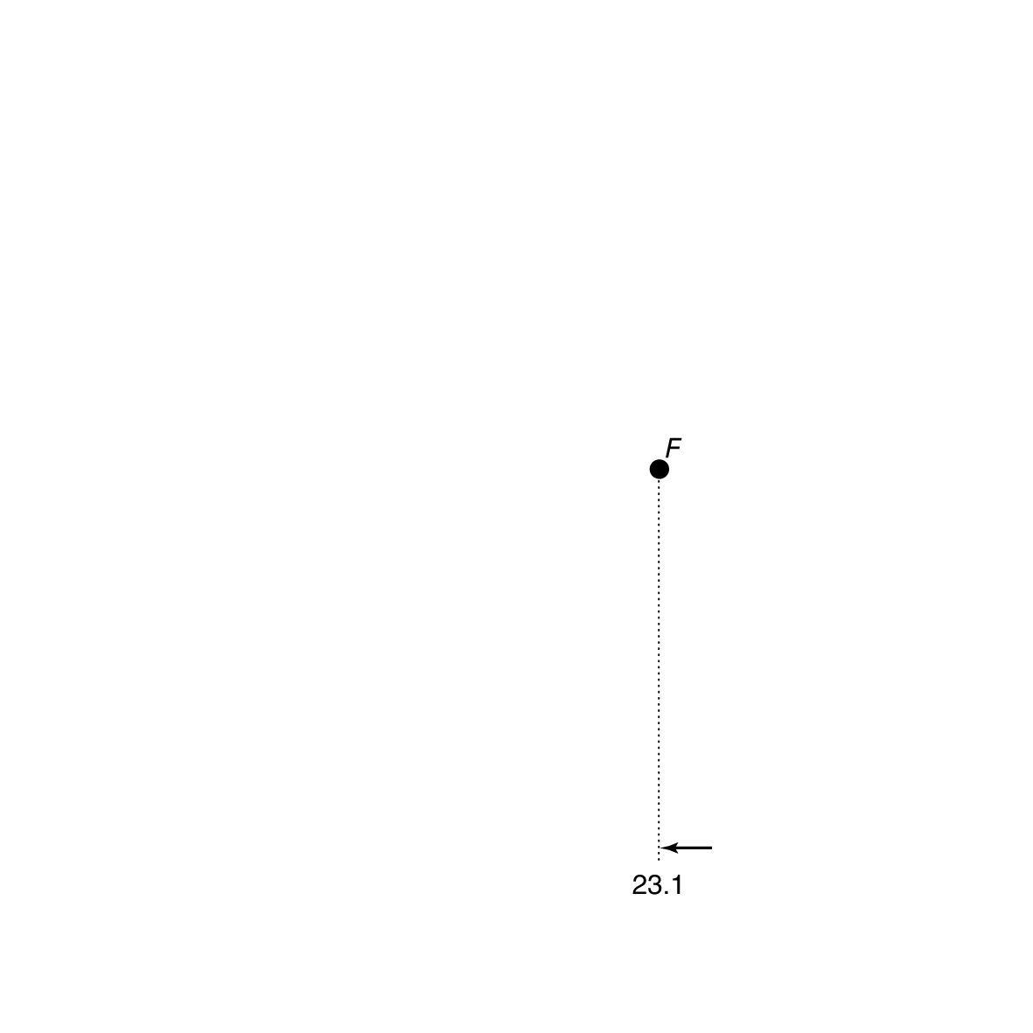

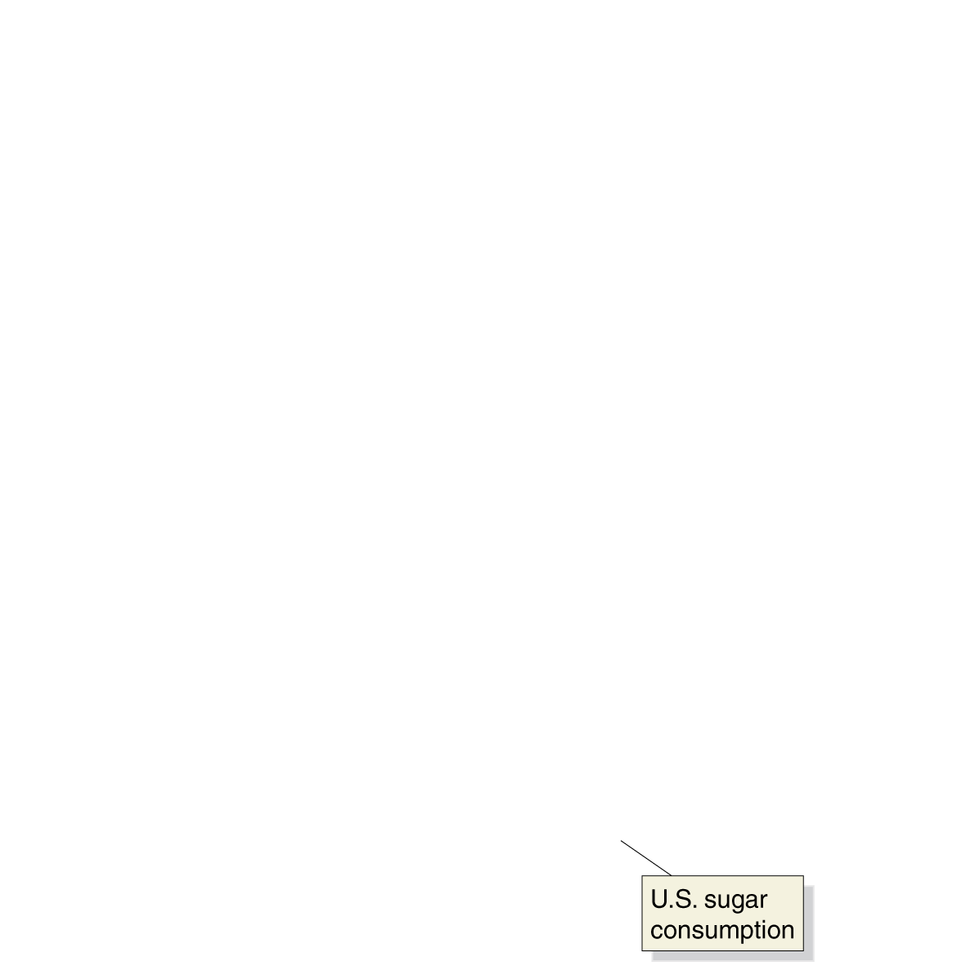


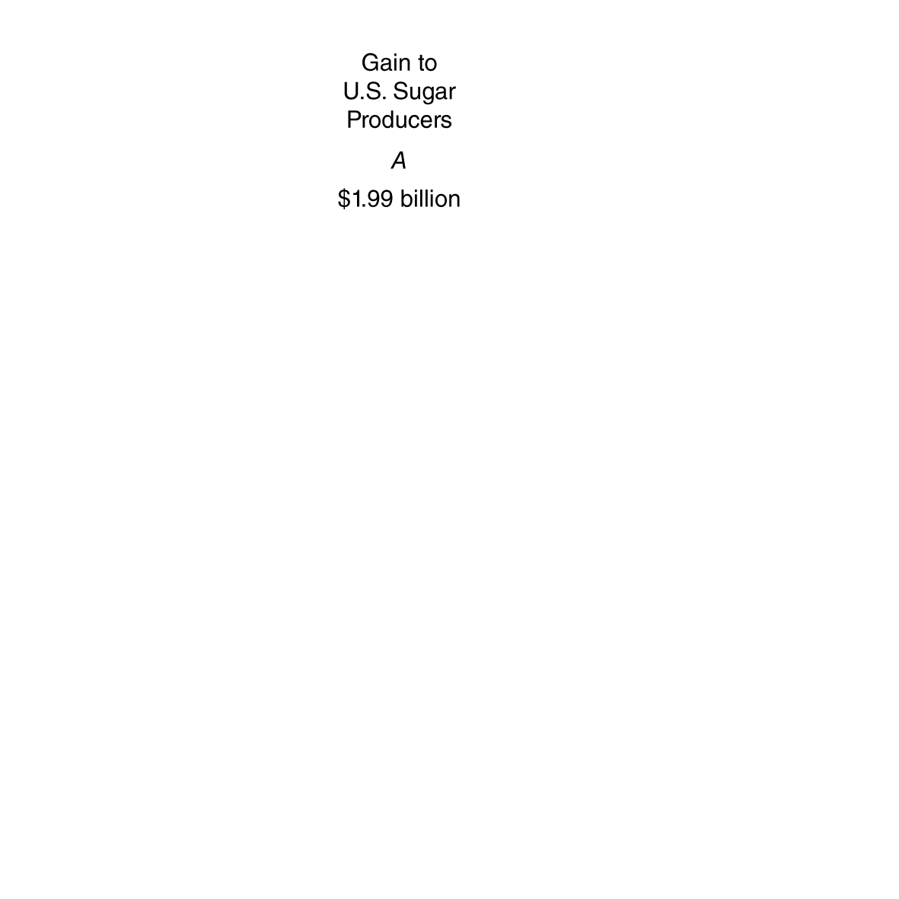

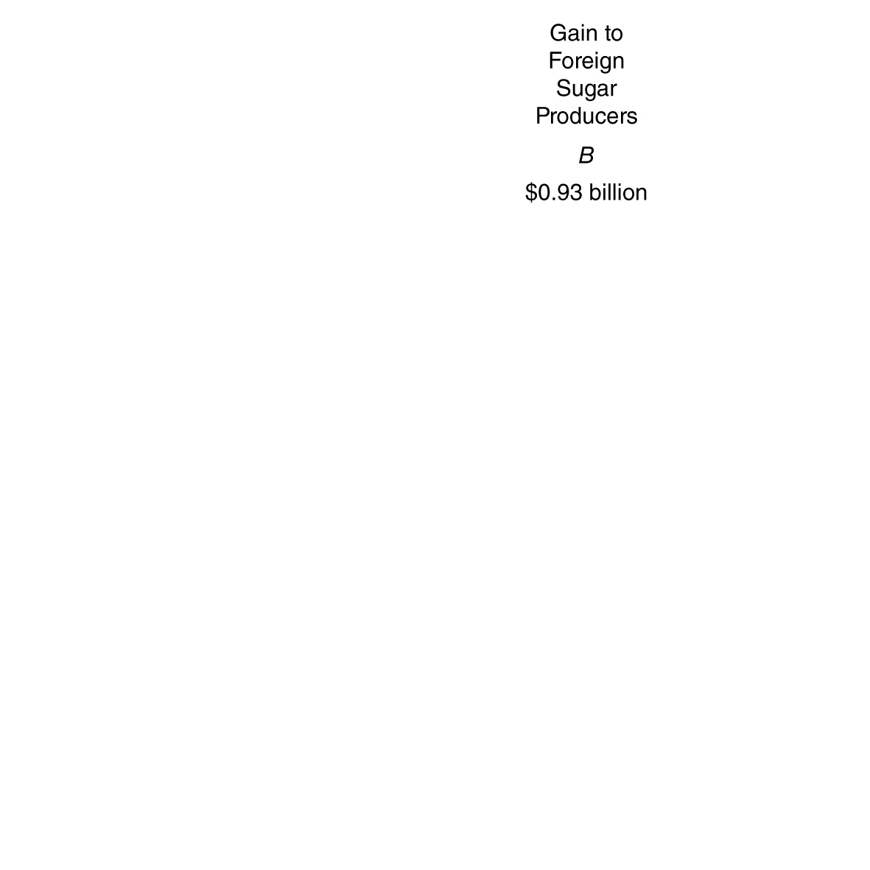

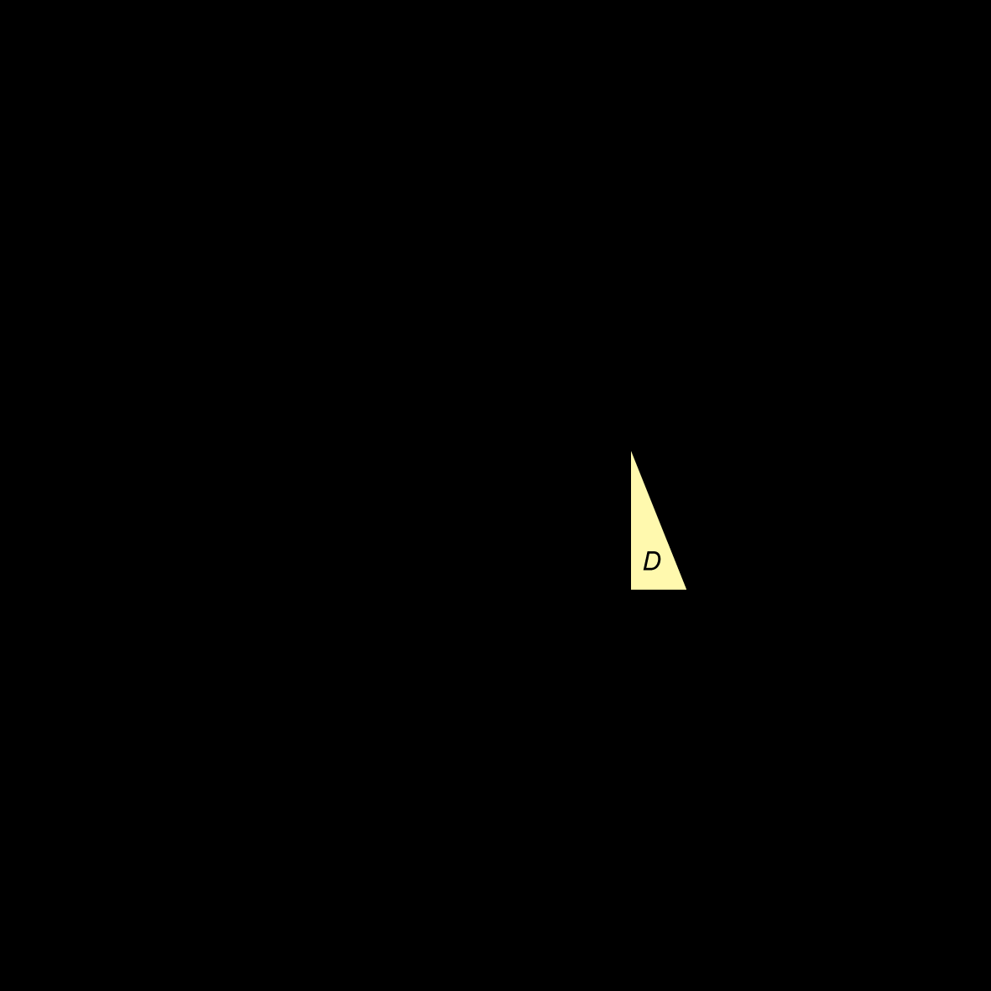


Economic impact of the sugar quota
If unlimited imports were allowed, America would import almost all of its sugar.
The sugar quota restricts imports, raising the U.S. price.
Quantity supplied by U.S. firms increases, resulting in increased producer surplus for U.S. firms.
Foreign sugar producers also gain, by selling at the U.S. price.
Consumer surplus falls by A+C+B+D (lower consumption, higher price).
Figure 9.7
The economic effect of the U.S. sugar quota
Notes:
Without a sugar quota, U.S. sugar producers
would have sold 7.6 billion pounds of sugar,
U.S. consumers would have purchased
25.7 billion pounds of sugar, and imports
would have been 18.1 billion pounds.
The U.S. price would have equaled the
world price of $0.27 per pound. Because
the sugar quota limits imports to 5.8 billion
pounds (the bracket in the graph), the
price of sugar in the United States rises to
$0.43 per pound, and U.S. producers supply
17.3 billion
pounds. U.S. consumers purchase
23.1 billion pounds rather than the
25.7 billion pounds they would purchase at
the world price. Without the import quota,
equilibrium would be at point E; with the
quota, equilibrium is at point F. The sugar
quota causes a loss of consumer surplus
equal to the area A + B + C + D. The area A
is the gain to U.S. sugar producers. The area
B is the gain to foreign sugar producers. The
areas C and D represent deadweight loss.
The total loss to U.S. consumers in 2012 was
$3.9 billion.

Slide 31
Costs to society of maintaining import restrictions
A common argument in favor of maintaining import restrictions is that it saves domestic jobs.
Economists estimate that without the sugar import restrictions, about 3,000 jobs in the U.S. sugar industry would be lost.
That means each job is costing U.S. consumers
$3.90 billion / 3,000 jobs = $1.3 million per job.
And this is probably an underestimate, since cheaper sugar would open up more jobs (in the candy industry, etc.), and encourage sugar-using manufacturers to remain in America.
Sugar producers are able to lobby for the tariffs because the cost to society of the tariffs is spread over many consumers, and the benefit is concentrated among just a few people.

Slide 32
Preserving U.S. jobs with tariffs and quotas is expensive
The cost to American consumers of maintaining import restrictions and tariffs is very high.
Product | Number of Jobs Saved | Cost to Consumers per Year for Each Job Saved
Benzenoid chemicals Luggage Softwood lumber Dairy products Frozen orange juice Ball bearings Machine tools Women's handbags Canned tuna | 216 226 605 2,378 609 146 1,556 773 390 | $1,376,435 1,285,078 1,044,271 685,323 635,103 603,368 479,452 263,535 257,640
Table 9.5
Preserving U.S. jobs with tariffs and quotas is expensive

Slide 33
And the same is true in Japan!
Japanese consumers also pay high prices to maintain Japanese jobs through import restrictions and tariffs.
Product | Cost to Consumers per Year for Each Job Saved
Rice Natural gas Gasoline Paper Beef, pork, and poultry Cosmetics Radio and television sets | $51,233,000 27,987,000 6,329,000 3,813,000 1,933,000 1,778,000 915,000
Table 9.6
Preserving Japanese jobs with tariffs and quotas is also expensive

Slide 34
The economic impact of the tariff
The U.S. tariff on Chinese tires was designed to protect U.S. tire-workers from foreign competition.
Consumers either paid the higher prices, or switched to buying tires imported from non-Chinese sources.
At most, the tariff saved 1,200 jobs while forcing tire consumers to pay $1.1 billion extra for tires—$900,000 per job saved.
Economists from the Petersen Institute for International Economics estimate that if that $1.1 billion had been spent on other retail products, it would have resulted in 3,731 more retail jobs.
So the tariff actually resulted in 2,500 fewer jobs.
The tire tariff was an expensive and ineffective way to preserve jobs.

Slide 35
Should the U.S. and Japan drop their tariffs?
Some politicians argue that we should drop our tariffs and quotas, but only if the Japanese (and other countries) agree to do the same.
This makes it easier to gain political support for actions that will genuinely cause economic pain, albeit to a limited number of people.
But our analysis showed that there is sufficient reason for America to unilaterally remove its restrictions.
The U.S. economy would gain from the elimination of tariffs and quotas even if other countries did not reduce their tariffs and quotas!

Slide 36
Other barriers to trade
A less-common but still important barrier to trade is the imposition of higher standards on imported goods.
Example: Raw milk can be sold in many U.S. states, but cannot be sold across state lines.
Many governments also restrict imports of certain products on national security grounds, fearing that in times of war, they would not have access to those products.
These arguments often seem quite cynical, however; for years, for example, the U.S. government would buy military uniforms only from U.S. manufacturers, even though uniforms are hardly a critical war material.

Slide 37
The Arguments over Trade Policies and Globalization
9.5
Evaluate the arguments over trade policies and globalization.

Slide 38
Trade agreements in the 21st century
More trade takes place between nations when their governments encourage rather than discourage it.
1930: U.S. institutes Smoot-Hawley Tariff, increasing tariffs to >50%. Goal is to “protect” domestic industry, encourage employment.
1948: Western countries seeking to revive international trade form GATT (General Agreement on Tariffs and Trade). Several “rounds” of multilateral tariff reduction followed.
1995: World Trade Organization (WTO) replaces GATT; >150 member states agree to liberalize international trade. WTO also provides dispute resolution process for trade disputes. Better coverage for non-physical products (intellectual property, etc.).
World Trade Organization: An international organization that oversees international trade agreements

Slide 39
Opposition to WTO and trade in general—part 1
Three main sources:
Anti-globalization forces
Lesser-developed countries (LDCs) have less strict regulations, creating perception of unfairness.
But regulations are a choice; in rich countries, we choose such regulations because we think they make us better off.
Free trade and foreign investment might “destroy” distinctive cultures.
Matter of opinion whether LDCs are better off with McDonalds and WalMart; but if they choose to eat and shop there, why should we deny them that right?
“Old-fashioned” protectionists
People perceiving WTO first-world bias

Slide 40
Opposition to WTO and trade in general—part 2
Three main sources:
Anti-globalization forces
“Old-fashioned” protectionists
Restricting trade “saves jobs” and “protects high wages”
We have seen that overall people are better off with trade, even though some individuals are worse off.
“Infant industries” need protection
Industries might need some time to “start-up” and become competitive; but tariffs must eventually be removed.
Protecting national security
Maybe we shouldn’t import all our guns from elsewhere...
People perceiving WTO first-world bias

Slide 41
Opposition to WTO and trade in general—part 3
Three main sources:
Anti-globalization forces
“Old-fashioned” protectionists
People perceiving WTO first-world bias
Does WTO favor high-income countries?
Maybe; less pressure can be brought to bear on large countries to remove their trade barriers.
Similarly, hard for third-world companies to compete (inferior infrastructure, etc.).
Inherent bias toward profits rather than equity.

Slide 42
Dumping
In recent years, The U.S. has protected some domestic industries using a WTO provision against dumping.
Dumping: selling a product for a price below its cost of production.
In practice, it is difficult to tell if foreign companies are dumping goods.
True production costs are not easy for governments to calculate.
WTO’s approach: countries can claim dumping if product is exported for lower price than it is sold domestically.
This standard is arbitrary; companies might use loss-leaders or different prices in different markets in order to maximize profits.

Slide 43
Positive vs. normative analysis
Recall positive analysis reflects “what is”, and normative analysis “what ought to be”.
Judgments about free trade necessarily reflect values and morals.
Though most economists disagree, it is not intellectually unreasonable to value the costs of free trade more highly than the benefits, and hence believe free trade is undesirable.
Note: not all tariffs/protectionist policies are identical; some are “worse” than others. Important not to “paint them all with the same brush”.

Slide 44

Unintended consequences of banning child labor
In rich nations, our reaction to child labor is one of horror: shouldn’t those children be in schools, getting education?
Often, this is not the reality: the alternative to work for those children is worse, like begging or prostitution.
This was the reality for Pakistani children when Baden Sports was forced by public pressure to move its production of soccer balls from Pakistan to China.
“Of the array of possible employment in which impoverished children might engage, soccer ball stitching is probably one of the most benign…”

Slide 45
Special interest groups and trade policy
Arguments against free trade in the U.S. often come from special interest groups, like the sugar industry complaining about “unfair competition from foreign producers”.
Although as a nation we would be better off without sugar quotas, they don’t get removed, because the sugar industry is able to successfully lobby the government to keep them.
The jobs that would be lost if the sugar quota were removed are much easier to identify than the ones that would be gained.
The burden of higher prices is spread across all 300+ million Americans.
Such arguments are easy to make, and hard for elected officials to ignore, even though it is correct to do so.

Slide 46
Common misconceptions to avoid
Comparative advantage is the basis for trade; a nation may have an absolute advantage in nothing or in everything, and still benefit from trade.
Tariffs are effectively taxes imposed on imports; they do not ban imports in any way.
Trade creates winners and losers; to claim otherwise is dishonest.
Whether free trade is good or not is a normative (value) judgment.
But economics can inform those value judgments.
Some parts of free trade are surely good; we must determine which parts are good, and which are not. It’s not “all or nothing”.

